Slide 1
Academic Analysis

Slide 2
Overview
Academic data which analyses the graduate and dropout rate of different nationalities.
This data has 4424 student records and 36 fields.
This data has been sourced from Kaggle. (Only for educational purposes)

Slide 3
Objective
Portugal Academic analysis is a project aimed to get a view on education amongst different nationalities, analyse graduation and dropout rates for Portuguese nationals and explore their reasons.
Generate insights on GDP and inflation rate for various nationalities.

Slide 4
Methodology
Data pre-processing and manipulation is done using Python and insights are drawn using Tableau.

Slide 5
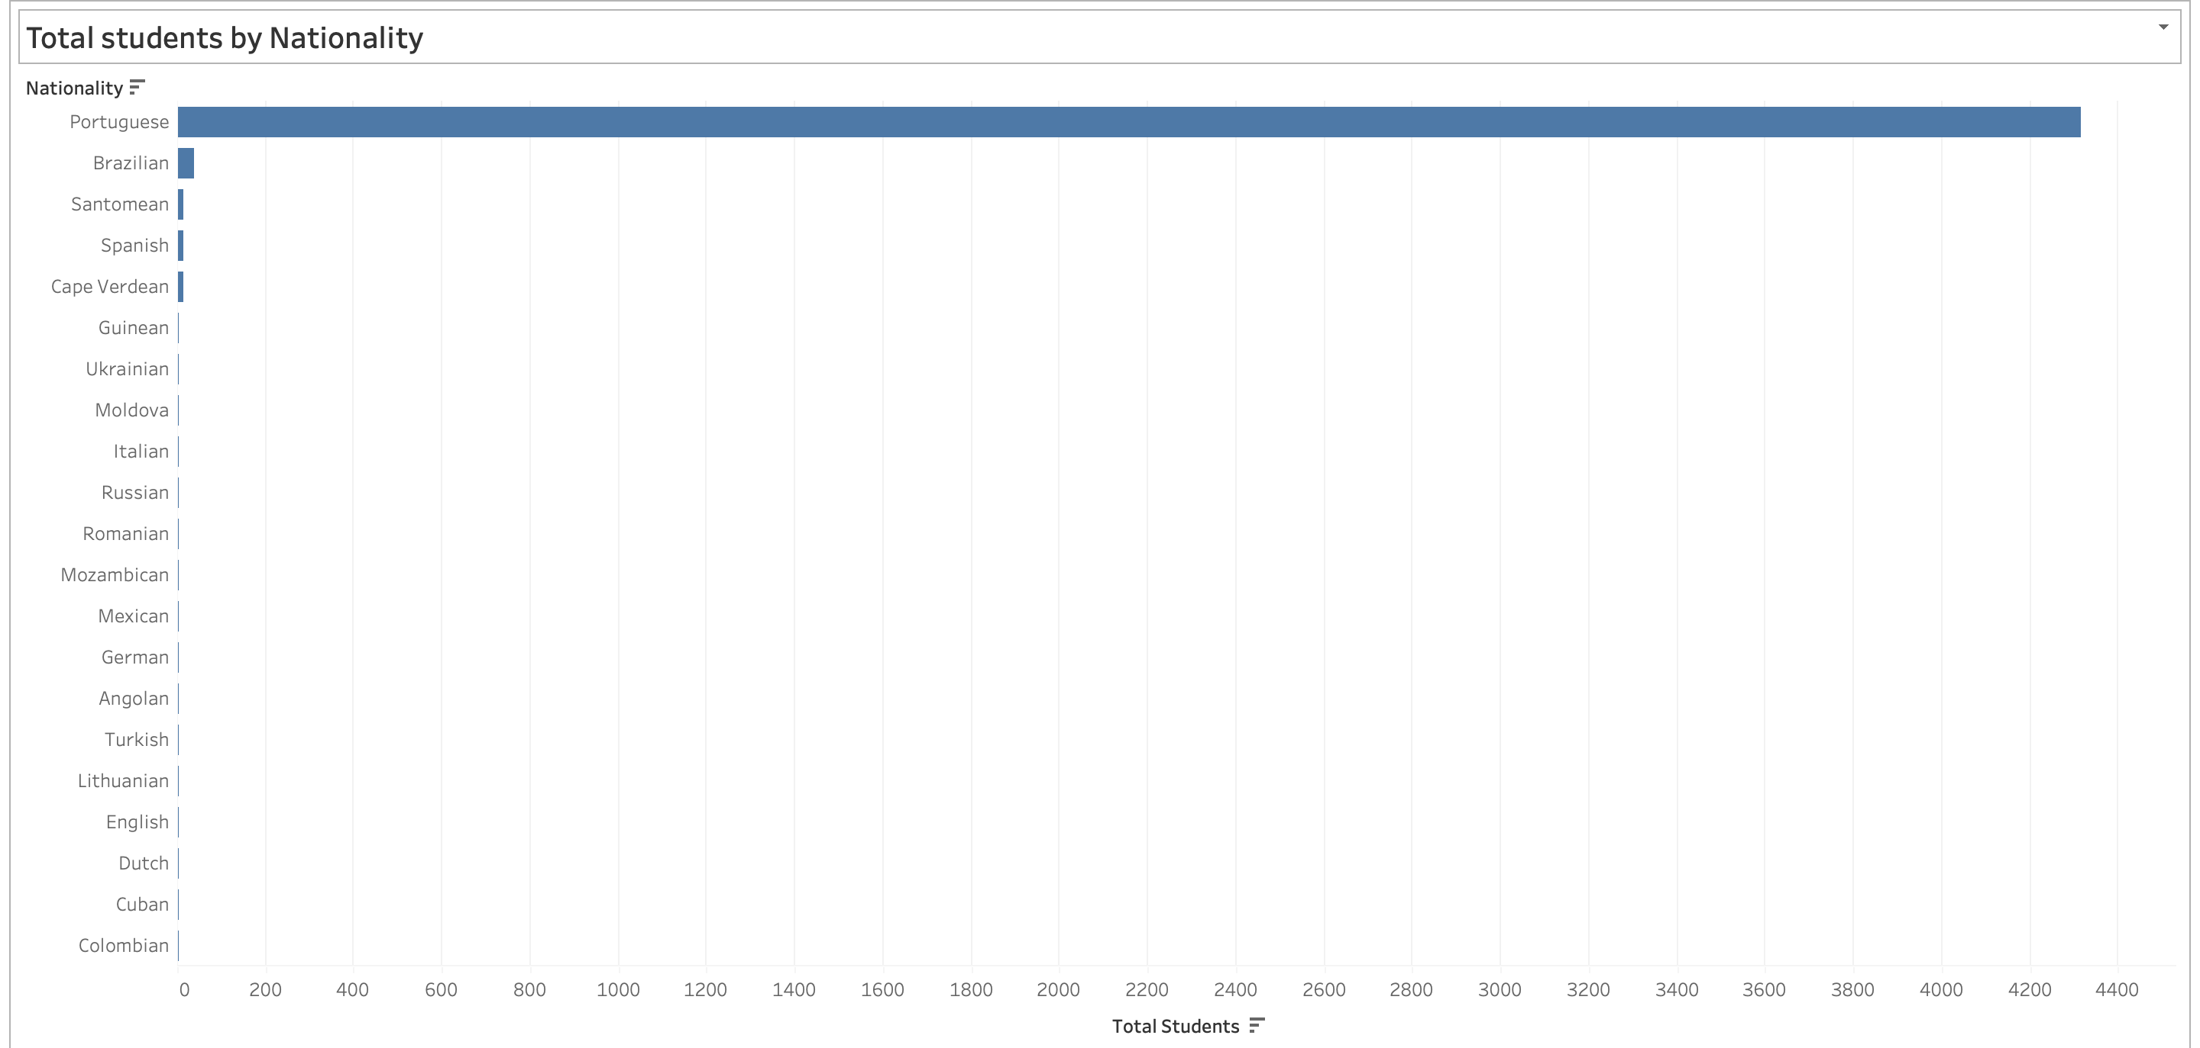
Results
Horizontal bar chart which represents Total students by Nationality. Y – axis represents various Nationalities, X – axis represents Total students.
Portuguese nationals constitute the majority number of students with 4300.

Slide 6
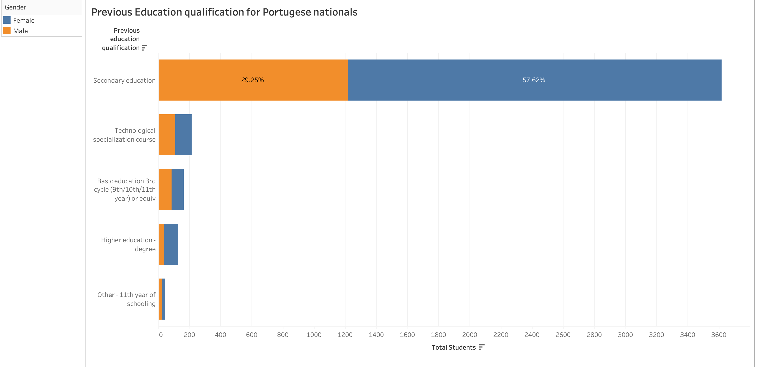
Horizontal bar chart portraying Previous education qualification for Portuguese nationals by gender. Y – axis represents Previous education qualifications, X – axis represents the Total number of students.
Overwhelming majority pupil with Secondary education as their previous education and Female’s contributing to nearly 58 percent of the entire 3600.

Slide 7
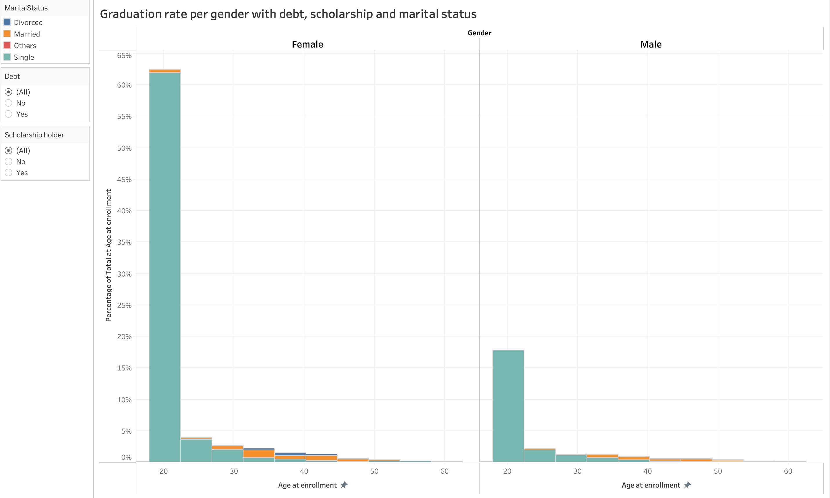
Stacked bar chart depicting effect of Graduation rate per gender with debt, scholarship and marital status. Y – axis represents Percentage of total people at age of enrolment, X – axis represents Age distribution for Female and Male separately.
Overall, graduation rate for female accounts for around 63 percent and 18 percent for male.

Slide 8
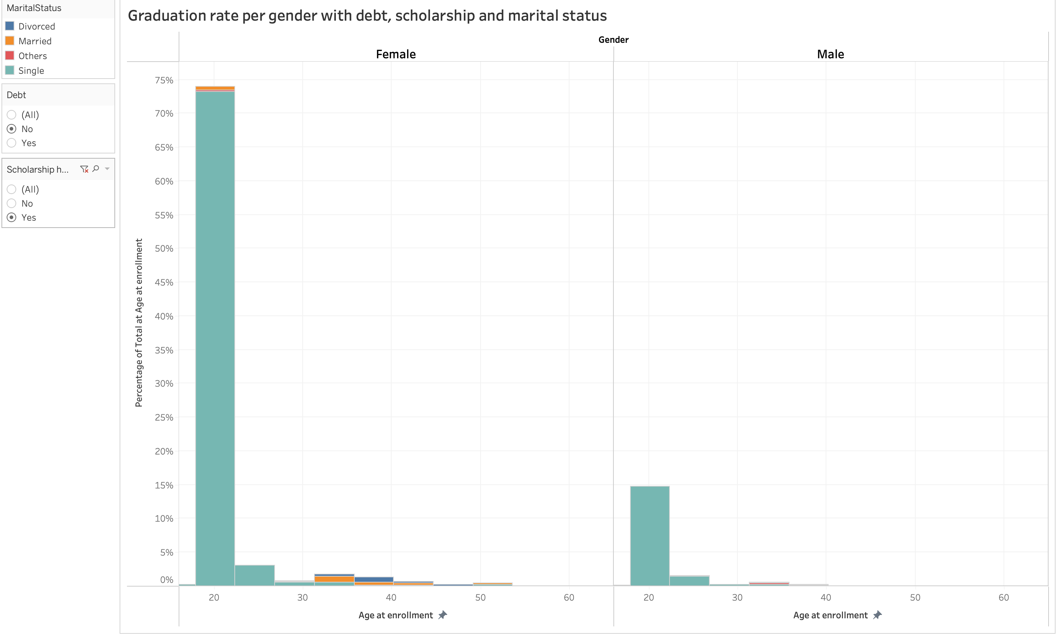
Graduation rate is at its highest for Female with nearly 75 percent, when they have NO debt and have a scholarship. . Majority of this being contributed by the ages 20 – 25 and most of their marital status being single.

Slide 9
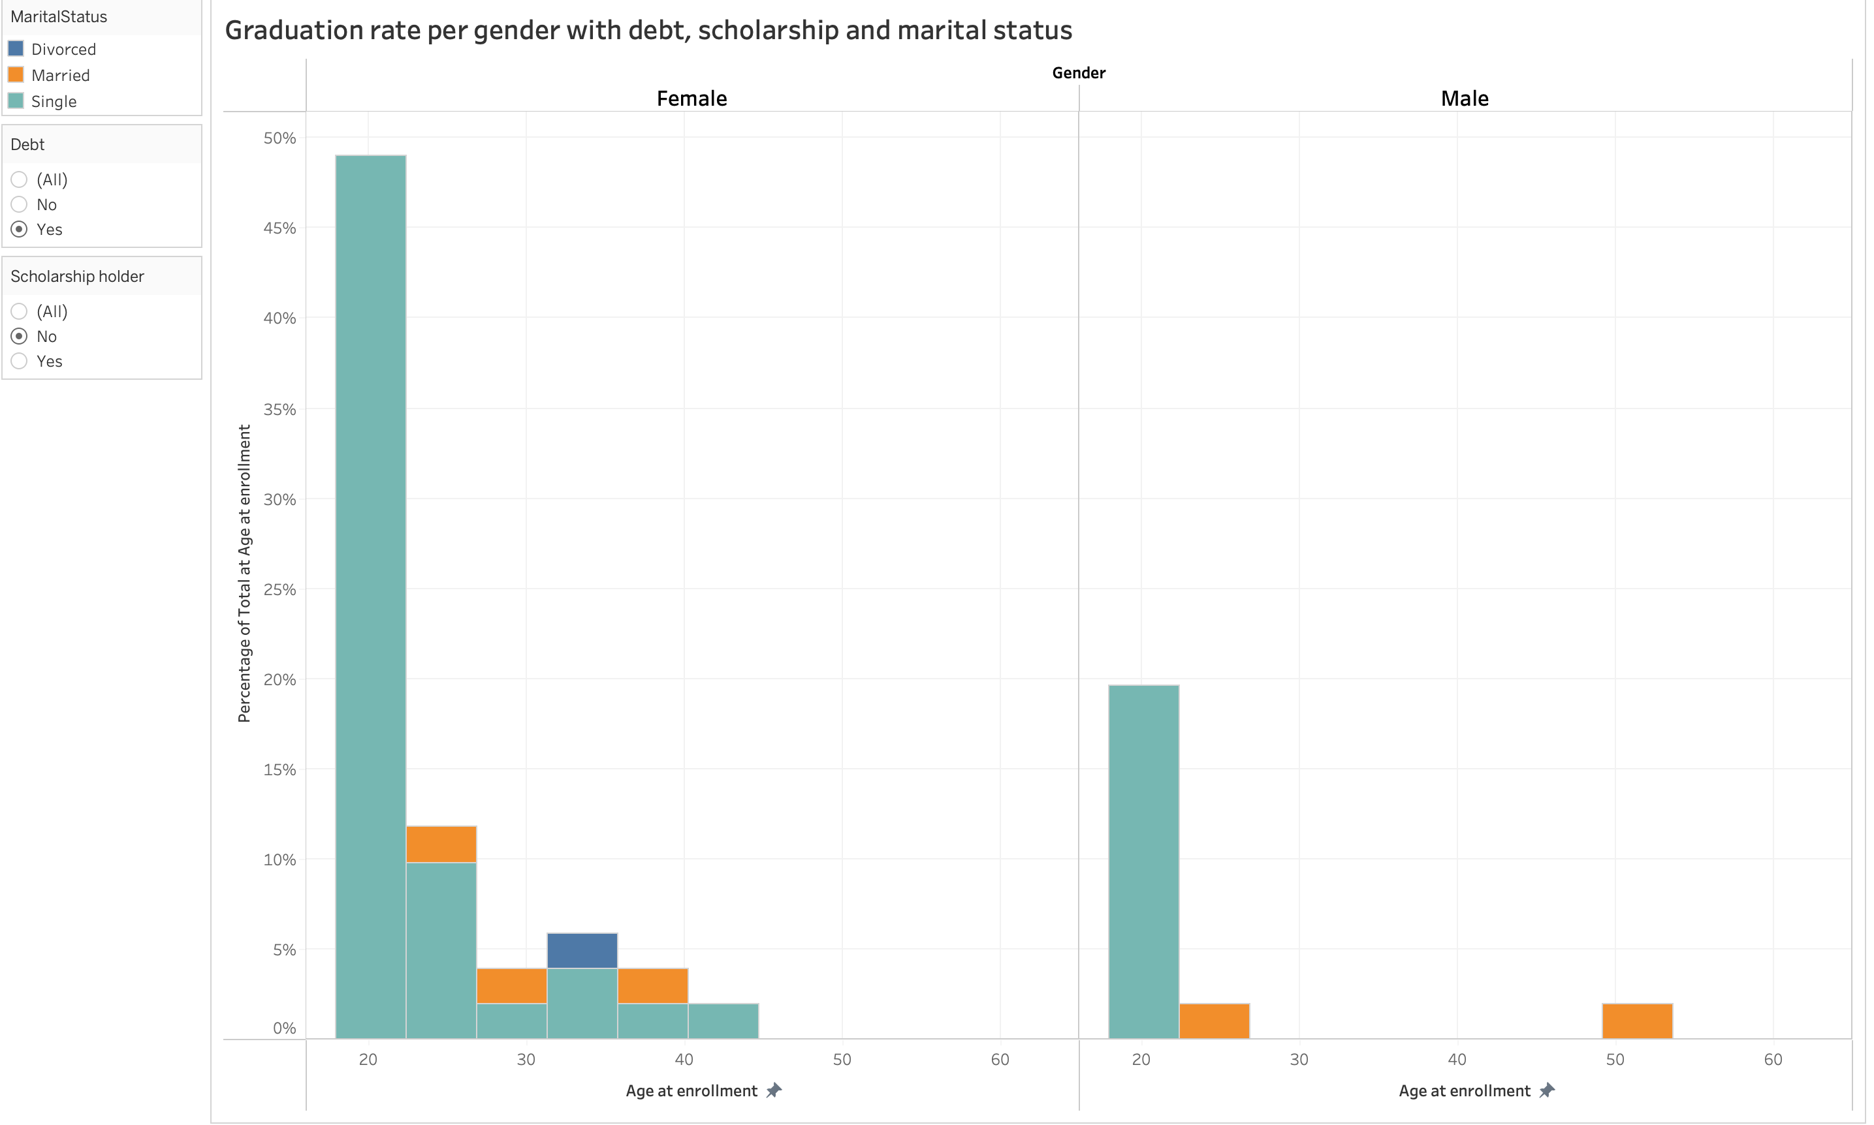
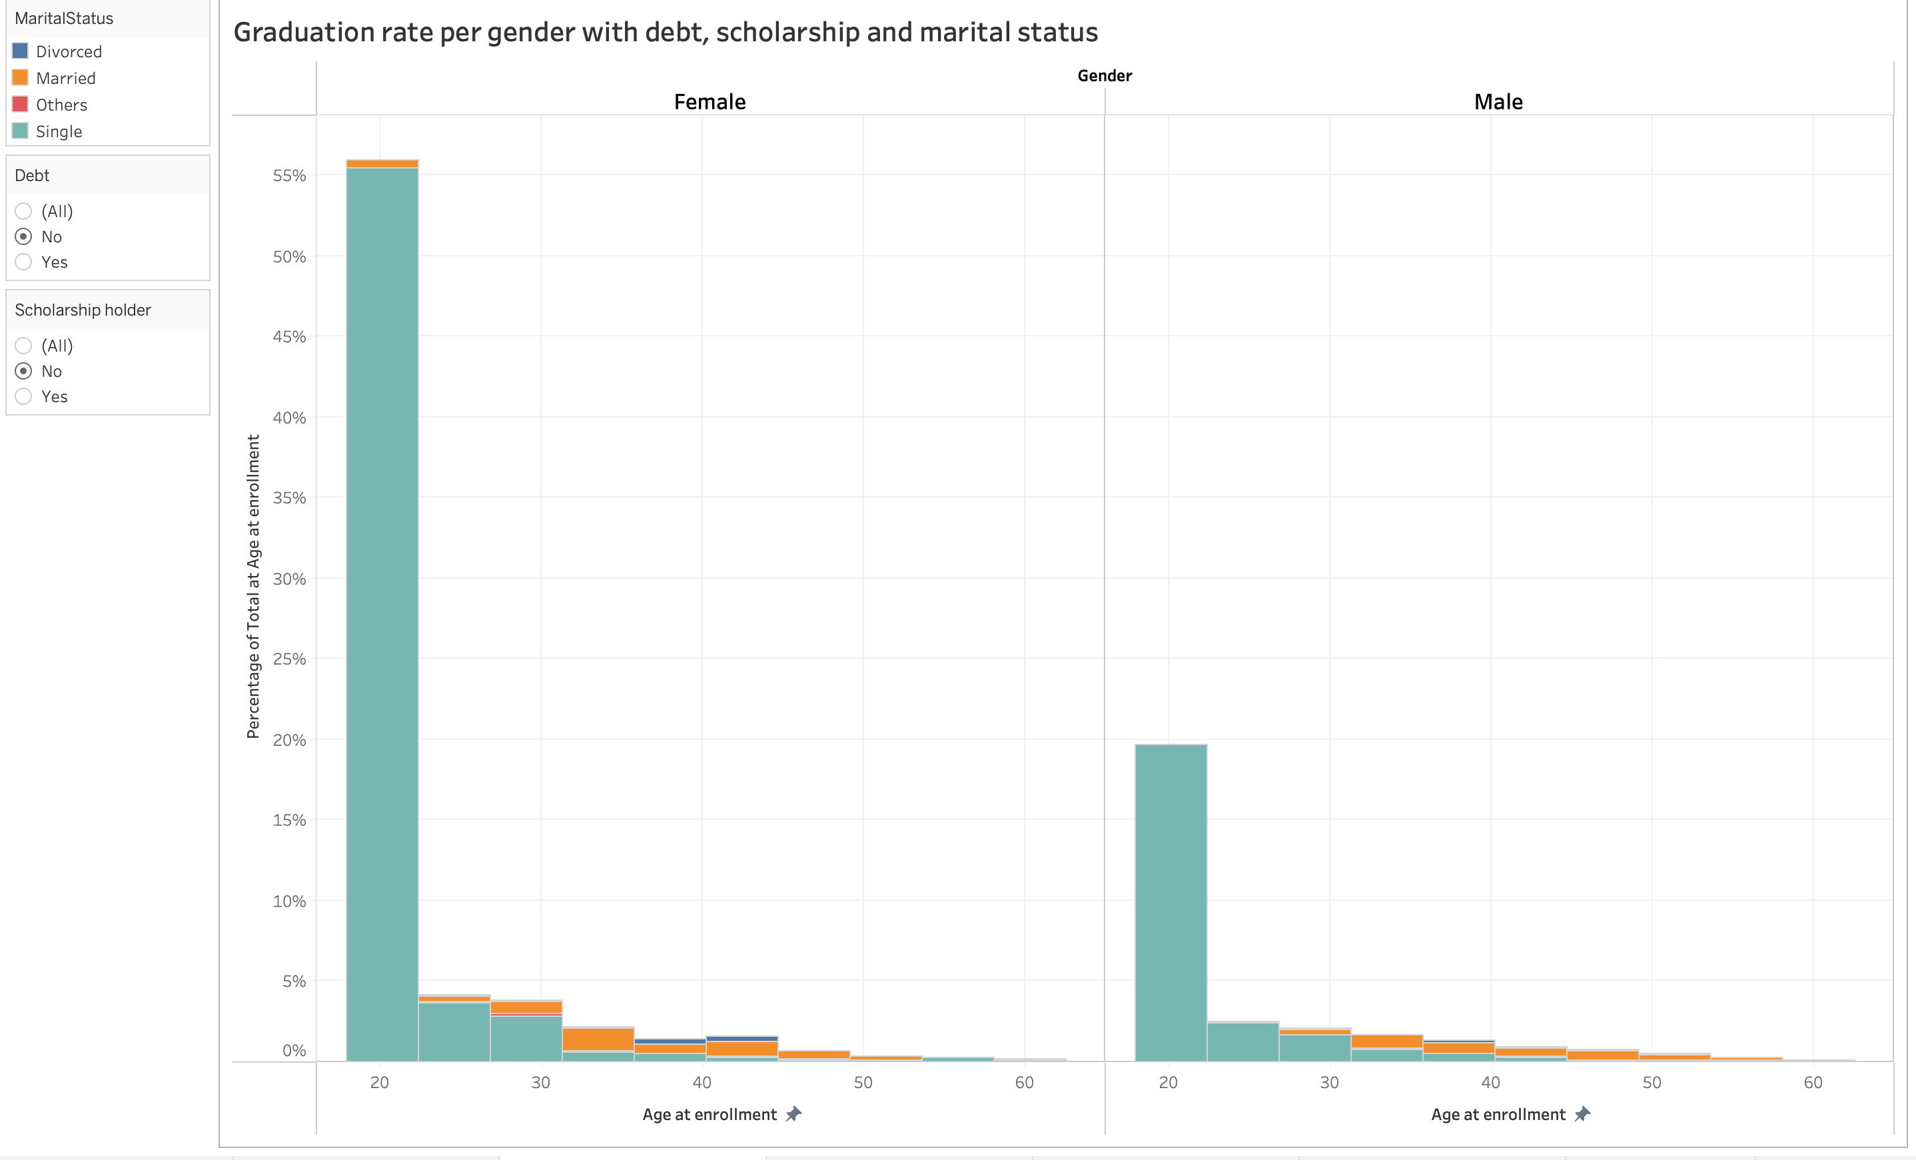
Graduation rate in Male students was at its highest at nearly 20 percent. However, debt and scholarships have no significant impact with graduating when compared to their female counterparts which had a significant effect.

Slide 10
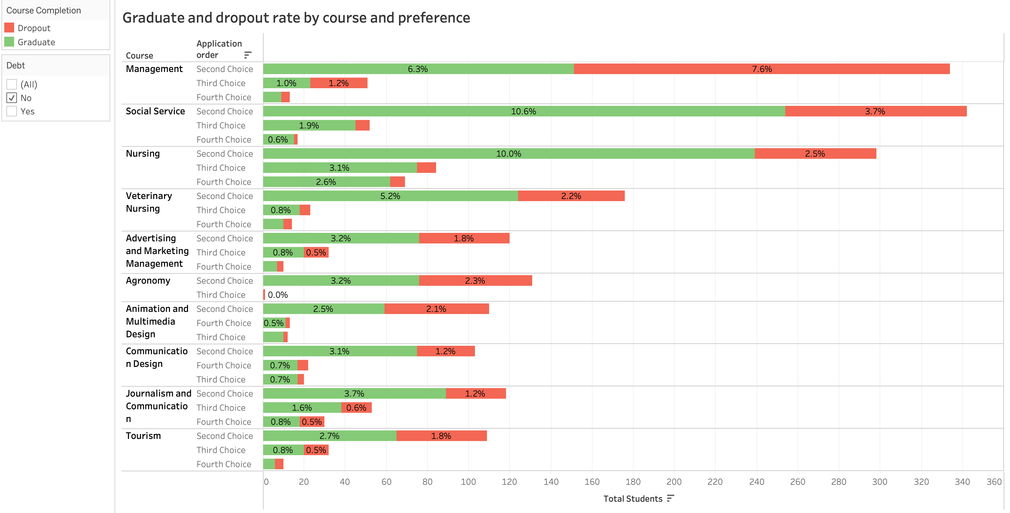
Horizontal stacked bar charts portraying Graduate and dropout rates for Portuguese nationals by course and their preference without debt. Y – axis represents Course and their preference, X – axis represents Total students on both the charts.
Coincidentally Social services, Nursing and Management courses had the highest graduation rate and dropout rates, all of their course preference being a second choice whilst Animation and multimedia, Communication design and Journalism had their least graduation percentage with their course preference being fourth.

Slide 11
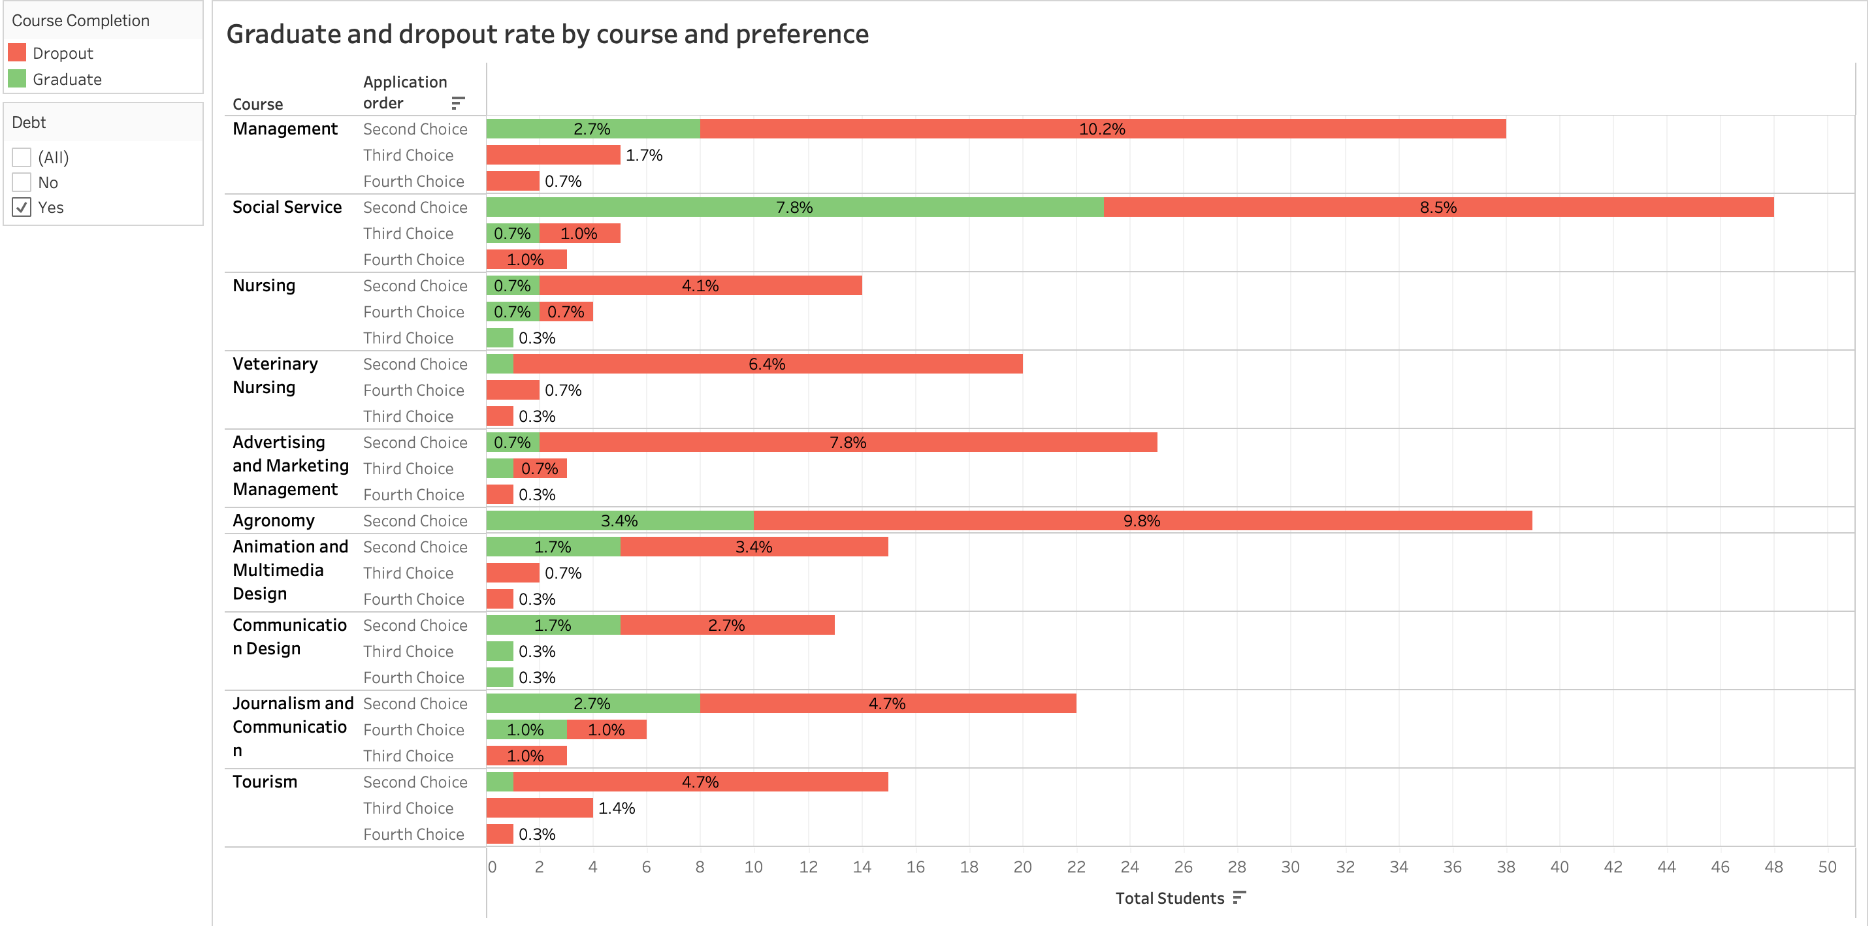
Horizontal stacked bar charts portraying Graduate and dropout rates for Portuguese nationals by course and their preference having debt. Y – axis represents Course and their preference, X – axis represents Total students on both the charts.
Management, Agronomy and Social service accounts for the highest dropout rate while Social service, Agronomy and Journalism having the highest graduation percent for students with debt.

Slide 12
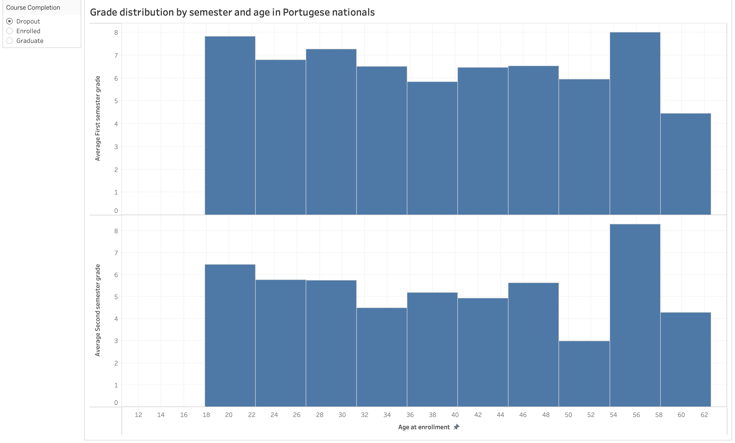
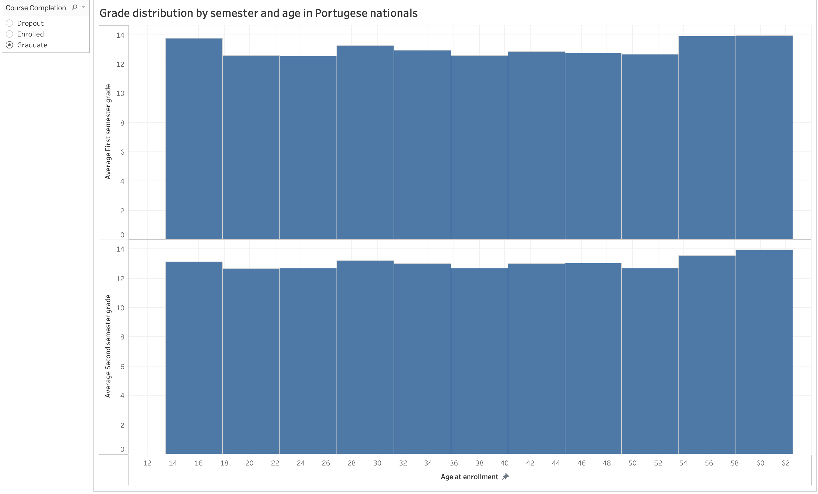
Histogram which explores Grades for Dropouts and Graduates of different age by semester. Image on left shows Grades for dropouts and image on right shows grades for graduate. Y – axis represents Average first semester grade and average second semester grade, X – axis represents Age.
Significant drop in grades of students who are dropouts compared to grades of graduates.
Highest grade being 8 for the age range of 54-58 and the lowest being 2 between the ages 50-52 in pair of the semesters.

Slide 13
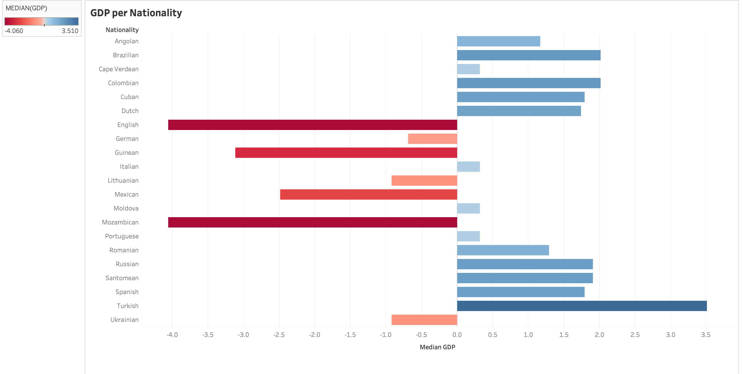
Bar chart portraying Median GDP per nationality.
Turkey, Brazil and Columbia are the three highest positive GDP growth nations.
England, Mozambique and Guinea have the highest negative GDP growth.

Slide 14
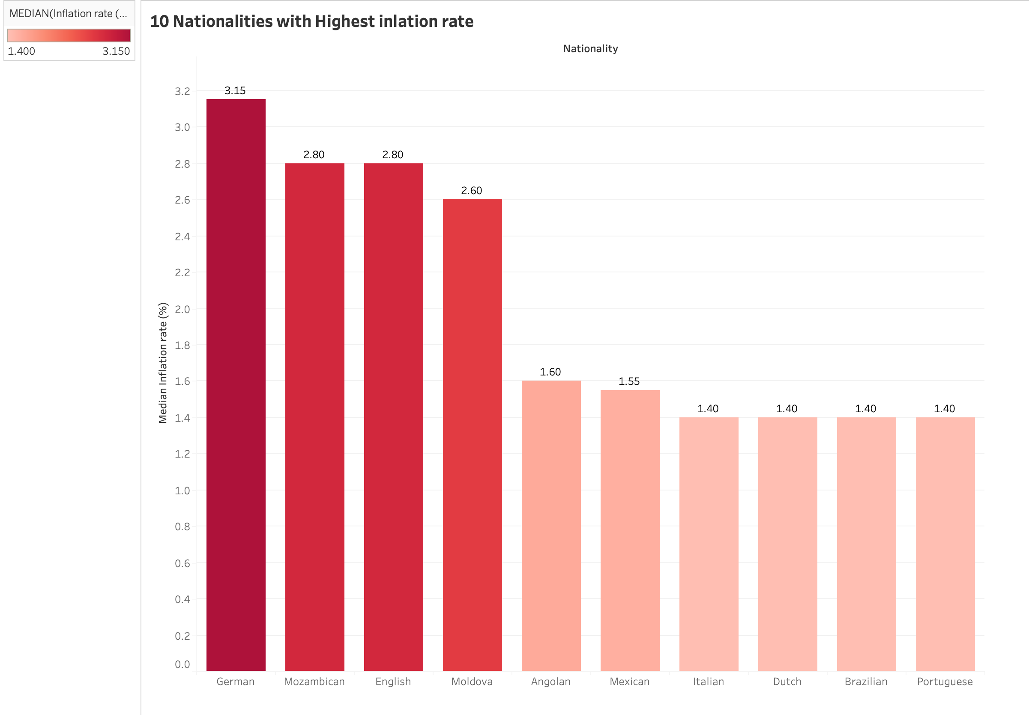
Bar chart depicting 10 nations with Highest inflation rate. Y- axis represents Median inflation rate percent, x – axis represents Nationality.
Germany is the has the highest inflation percent (3.15), Mozambique and England are the two nations with second highest inflation percent (2.8 each).

Slide 15
Conclusion
Majority of the data belongs Portuguese nationals where female students had the highest graduation rate.
Debt plays a significant role in their graduation and dropout rates.

